Slide 1

LTG Conference
Health and Safety
Lee Simcox
Safeguarding
Caroline Kendall

Slide 2
1
There are 3 things that are needed for a fire to exist.
Together they are called…
A
B
The fire circle
The fire triangle
C
D
The fire square
The fire tetrahedron

Slide 3
2
One of Pete’s projectors has caught fire!
Which type of fire extinguisher can be used to fight the fire?
A
B
Water
Foam
C
D
Carbon dioxide
Powder

Slide 4

3
How quickly do people have to run to escape from the building?

Slide 5
4
How many trained first aiders do we need in the theatre?
A
At least 1 at all times
B
1 for every 100 customers
C
1 for every 15 staff members
D
None

Slide 6
5
What PPE does Rod need when he goes up in the scissor lift?
A
B
Hard hat
Harness
C
D
Gloves
Safety boots

Slide 7
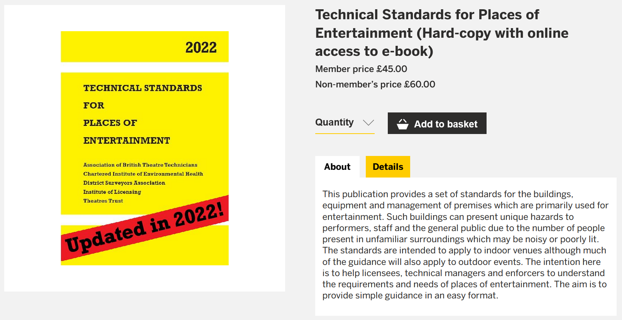
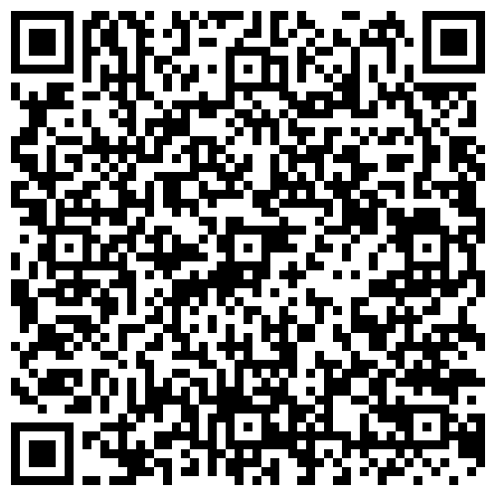

Slide 8
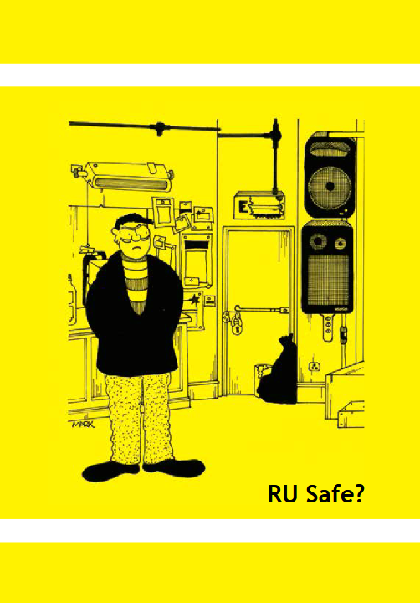
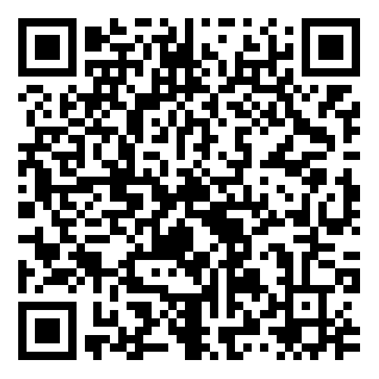
https://littletheatreguild.org/wp-content/uploads/2019/03/rusafe.pdf

Slide 9
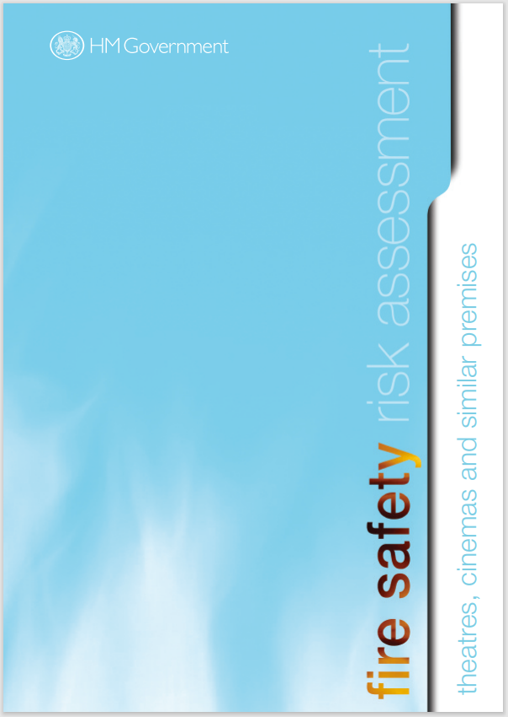
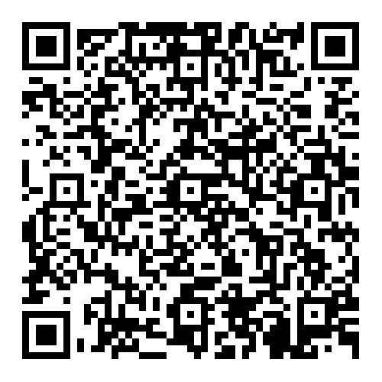
https://www.gov.uk/government/publications/fire-safety-risk-assessment-theatres-cinemas-and-similar-premises

Slide 10
What are the legal requirements?
Carry out risk assessments (COSHH, WAH)
Inspection of lifting equipment (Lifts, powered access, winches, accessories)
Gas safety checks
Inspection of fixed wiring installation
Check electrical equipment is in good condition
Ensure equipment is safe and is maintained
Provide PPE to control risks
Have an asbestos management plan
Food safety & hygiene
Carry out fire risk assessment
Fire alarm test – weekly
Fire alarm service – annual
Fire extinguisher service – annual
Emergency lighting test – monthly
Plan for an emergency
Provide information, instruction and training
Fire safety measures

Slide 11
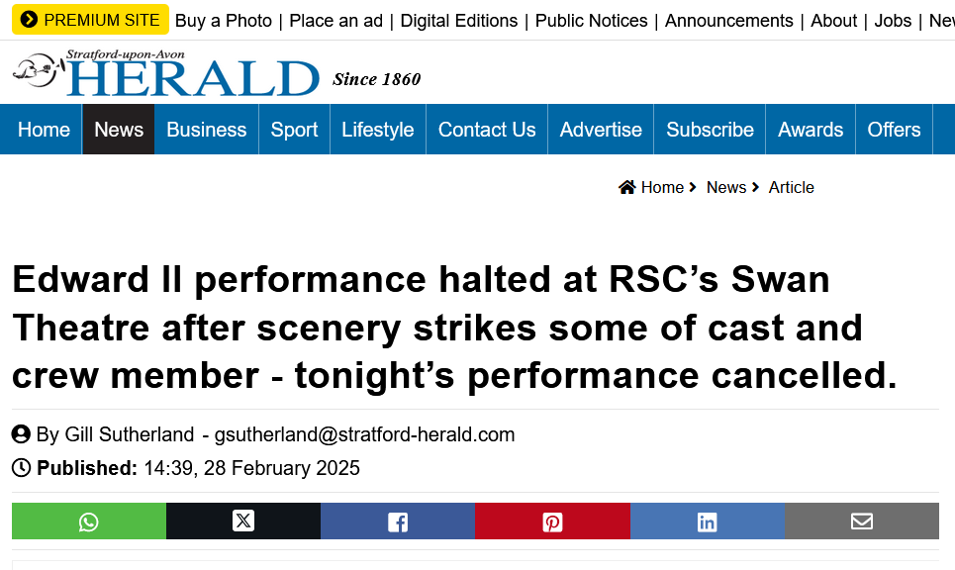
Emergencies

Slide 12
Emergencies
Fire
Medical incident
Flood
Gas leak
Bomb threat
Public disorder

Slide 13



Emergency Plan
Detection of the emergency
Where and what?
Alerting staff and assessing the situation
SHOW STOP – how live performances will be stopped
Evacuation if necessary
Evacuation procedure
How the evacuation of the premises should be carried out
The role of specific people
Identification of key escape routes
How the emergency services will be called
Assembly point
Location of key equipment
Prepared in a written plan – details in fire safety guidance
Good communication is essential!

Slide 14
Risk Assessments
General
Fire
Production
Building specific:
Electricity
First aid
Safeguarding
Noise
Slips, trips and falls
Ventilation
Hazardous substances
Work at height
Use of equipment
Fire hazards
Fire precautions
Production specific:
Set planning
Stability of scenery
Flame retardancy
Rostra
Rigging
Moving set/furniture/props
Slips, trips and falls
Special effects

Slide 15
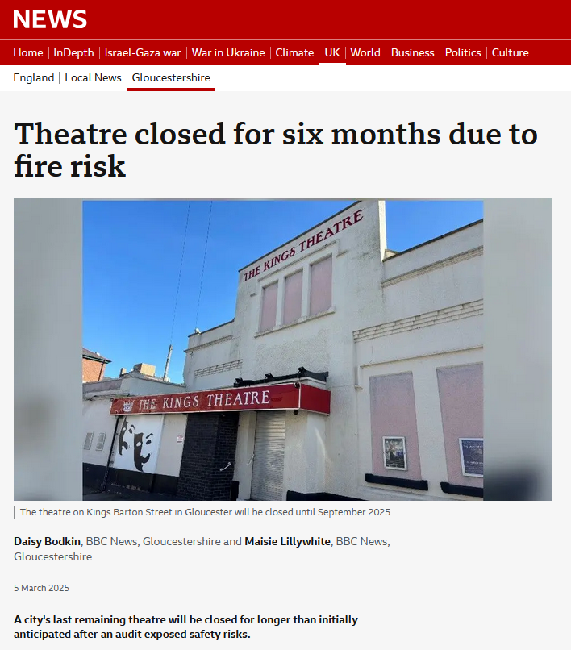
Fire Risk Assessment
Major flaws in the fire alarm and detection system
Unsuitable escape routes
Curtains and chairs not fire retardant

Slide 16
Fire Risk Assessment
Identify fire hazards
Means of escape
Escape routes
Travel distances
Exits
Fire resisting construction
Compartmentation
Fire doors
LOCATION
TYPE
Emergency lighting
Fire safety signage
Bar
Lounge
Auditorium
Studio
Electricals
Flammables
Combustibles
Fire alarm and detection system
Fire extinguishing systems
Management of fire safety
Evacuation strategy
Training and drills
Testing and recording

Slide 17

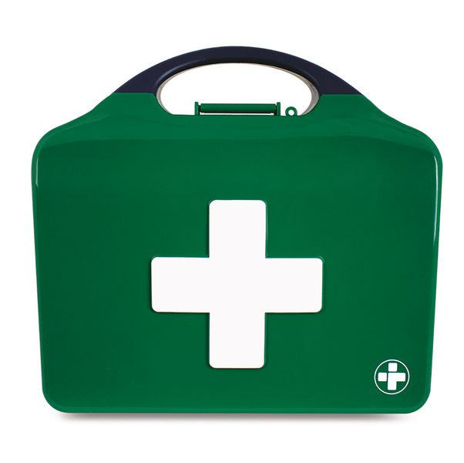
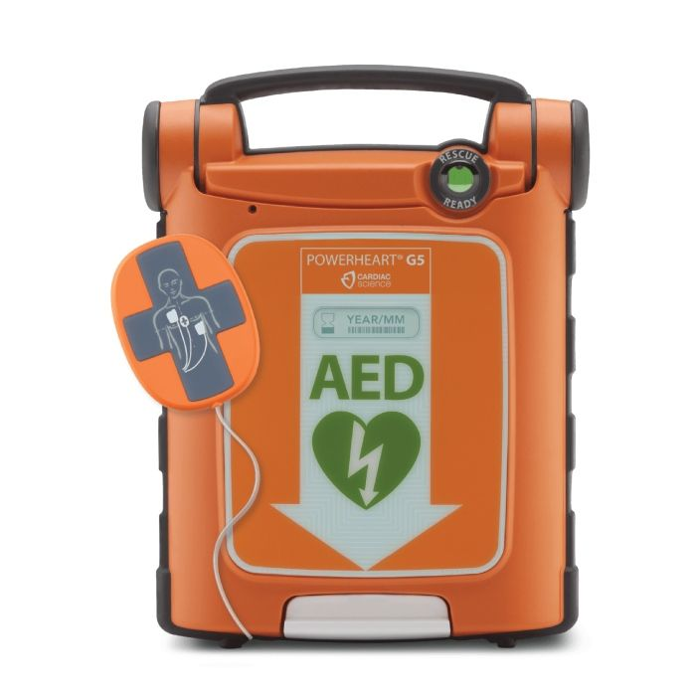
First Aid
Provide adequate and appropriate equipment, facilities and personnel
NO legal duty to make first aid provision for non-employees – HOWEVER duty of care
Who?
Minimum at least one first aid trained person present during a performance
Ideally Front of House Manager
Stage Manager
First aid training:
Emergency First Aid at Work (1 day)
First Aid at Work (3 day)
Stocked first aid kit
All components in date
Automated external defibrillator

Slide 18
Martyn’s Law
Terrorism (Protection of Premises) Act 2025
Am I affected?
Capacity less than 200 = not in scope
Capacity 200 – 799 = standard tier
What do I have to do?
Notify the regulator (SIA)
Put in place appropriate public protection procedures
No requirement for physical measures (at standard tier)
When?
April 2027

Slide 19
Safeguarding

Slide 20
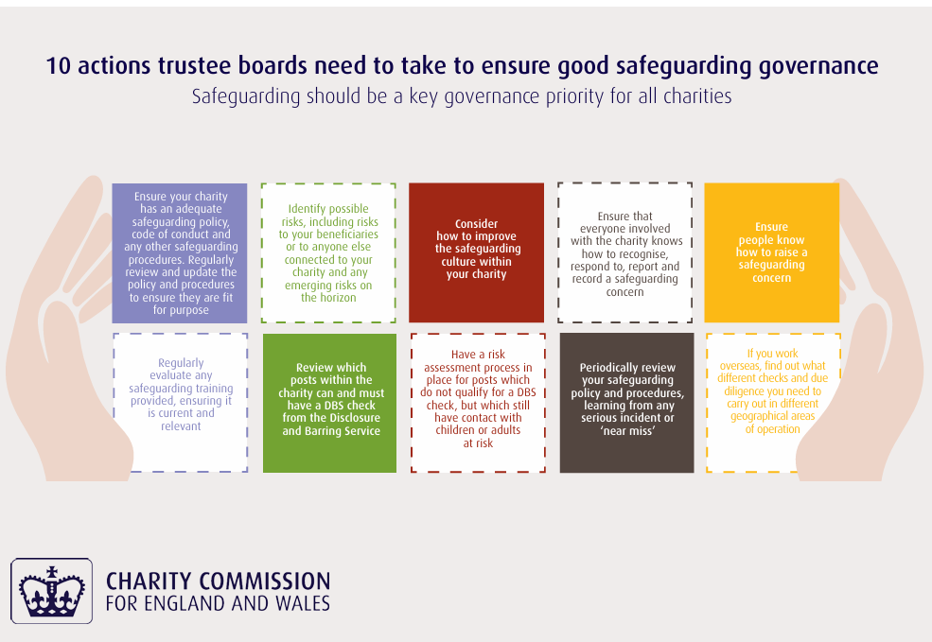

Slide 21
Thank you!
Safeguarding for everyone, everyone looking out for each other!
H&S
Lee Simcox
l.simcox@hotmail.co.uk
Safeguarding
Caroline Kendall
carolinekendall069@gmail.com

